Slide 1


Chapter 8
NP and Computational
Intractability
Slides by Kevin Wayne.
Copyright © 2005 Pearson-Addison Wesley.
All rights reserved.

Slide 2
8.3 Definition of NP

Slide 3
Decision Problems
Decision problem.
  X is a set of strings.
  Instance: string s.
  Algorithm A solves problem X: A(s) = yes iff s ∈ X.
Polynomial time. Algorithm A runs in poly-time if for every string s, A(s) terminates in at most p(|s|) "steps", where p(⋅) is some polynomial.
PRIMES: X = { 2, 3, 5, 7, 11, 13, 17, 23, 29, 31, 37, …. }
Algorithm. [Agrawal-Kayal-Saxena, 2002] p(|s|) = |s|⁸.
length of s

Slide 4
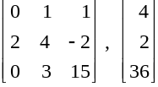
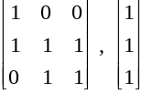
Definition of P
P. Decision problems for which there is a poly-time algorithm.
-→ Finding solution is easy
Problem | Description | Algorithm | Yes | No
MULTIPLE | Is x a multiple of y? | Grade school division | 51, 17 | 51, 16
RELPRIME | Are x and y relatively prime? | Euclid (300 BCE) | 34, 39 | 34, 51
PRIMES | Is x prime? | AKS (2002) | 53 | 51
EDIT-DISTANCE | Is the edit distance between x and y less than 5? | Dynamic programming | niether neither | acgggt ttttta
LSOLVE | Is there a vector x that satisfies Ax = b? | Gauss-Edmonds elimination
Notes:
[-1 2 2]

Slide 5
NP
Finding solution is hard, but certifying that a solution is correct is relatively easy.
Certification algorithm intuition.
  Certifier views things from "managerial" viewpoint.
  Certifier doesn't determine whether s ∈ X on its own;
  rather, it checks a proposed proof t that s ∈ X.
Def. Algorithm C(s, t) is a certifier for problem X if for every string s, s ∈ X iff there exists a string t such that C(s, t) = yes.
NP. Decision problems for which there exists a poly-time certifier.
Remark. NP stands for nondeterministic polynomial-time.
"certificate" or "witness"
C(s, t) is a poly-time algorithm and
|t| ≤ p(|s|) for some polynomial p(⋅).
Notes:
NP is the set of all decision problems (questions with a yes-or-no answer) for which the 'yes'-answers can be verified in polynomial time (O(n^{k}) where n is the problem size, and k is a constant) by a deterministic Turing machine.
NP is the set of all decision problems for which the instances where the answer is "yes" have efficiently verifiable proofs of the fact that the answer is indeed "yes". More precisely, these proofs have to be verifiable inpolynomial time by a deterministic Turing machine. In an equivalent formal definition, NP is the set of decision problems where the "yes"-instances can be accepted in polynomial time by a non-deterministic Turing machine. The equivalence of the two definitions follows from the fact that an algorithm on such a non-deterministic machine consists of two phases, the first of which consists of a guess about the solution, which is generated in a non-deterministic way, while the second consists of a deterministic algorithm that verifies or rejects the guess as a valid solution to the problem.^{[2]}
In a deterministic Turing machine, the set of rules prescribes at most one action to be performed for any given situation. By contrast, a non-deterministic Turing machine (NTM) may have a set of rules that prescribes more than one action for a given situation. For example, a non-deterministic Turing machine may have both "If you are in state 2 and you see an 'A', change it to a 'B' and move left" and "If you are in state 2 and you see an 'A', change it to a 'C' and move right" in its rule set.
How does the NTM "know" which of these actions it should take? There are two ways of looking at it. One is to say that the machine is the "luckiest possible guesser"; it always picks a transition that eventually leads to an accepting state, if there is such a transition. The other is to imagine that the machine "branches" into many copies, each of which follows one of the possible transitions. Whereas a DTM has a single "computation path" that it follows, an NTM has a "computation tree". If at least one branch of the tree halts with an "accept" condition, we say that the NTM accepts the input.

Slide 6
Certifiers and Certificates: Composite
COMPOSITES. Given an integer s, is s composite?
Certificate. A nontrivial factor t of s. Note that such a certificate exists iff s is composite. Moreover |t| ≤ |s|.
Certifier.
Instance. s = 437,669.
Certificate. t = 541 or 809.
Conclusion. COMPOSITES is in NP.
boolean C(s, t) {
if (t ≤ 1 or t ≥ s)
return false
else if (s is a multiple of t)
return true
else
return false
}
437,669 = 541 × 809
Notes:
The two definitions of NP as the class of problems solvable by a nondeterministic Turing machine (TM) in polynomial time and the class of problems verifiable by a deterministic Turing machine in polynomial time are equivalent. The proof is described by many textbooks, for example Sipser's Introduction to the Theory of Computation, section 7.3.
To show this, first suppose we have a deterministic verifier. A nondeterministic machine can simply nondeterministically run the verifier on all possible proof strings (this requires only polynomially many steps because it can nondeterministically choose the next character in the proof string in each step, and the length of the proof string must be polynomially bounded). If any proof is valid, some path will accept; if no proof is valid, the string is not in the language and it will reject.
Conversely, suppose we have a nondeterministic TM called A accepting a given language L. At each of its polynomially many steps, the machine's computation tree branches in at most a finite number of directions. There must be at least one accepting path, and the string describing this path is the proof supplied to the verifier. The verifier can then deterministically simulate A, following only the accepting path, and verifying that it accepts at the end. If A rejects the input, there is no accepting path, and the verifier will always reject.

Slide 7
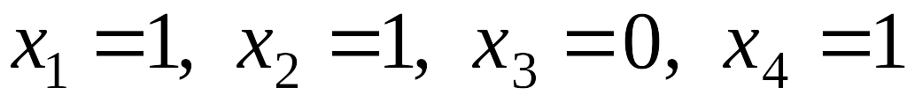
Certifiers and Certificates: 3-Satisfiability
SAT. Given a CNF formula Φ, is there a satisfying assignment?
Certificate. An assignment of truth values to the n boolean variables.
Certifier. Check that each clause in Φ has at least one true literal.
Ex.
Conclusion. SAT is in NP.
instance s
certificate t
Notes:
In particular, nondeterministic Turing machines are equivalent with deterministic Turing machines. This equivalency refers to what can be computed, as opposed to how quickly.
NTMs effectively include DTMs as special cases, so it is immediately clear that DTMs are not more powerful. It might seem that NTMs are more powerful than DTMs, since they can allow trees of possible computations arising from the same initial configuration, accepting a string if any one branch in the tree accepts it.
However, it is possible to simulate NTMs with DTMs: One approach is to use a DTM of which the configurations represent multiple configurations of the NTM, and the DTM's operation consists of visiting each of them in turn, executing a single step at each visit, and spawning new configurations whenever the transition relation defines multiple continuations.

Slide 8
Certifiers and Certificates: Hamiltonian Cycle
HAM-CYCLE. Given an undirected graph G = (V, E), does there exist a simple cycle C that visits every node?
Certificate. A permutation of the n nodes.
Certifier. Check that the permutation contains each node in V exactly once, and that there is an edge between each pair of adjacent nodes in the permutation.
Conclusion. HAM-CYCLE is in NP.
instance s
certificate t

Slide 9
P, NP, EXP
P. Decision problems for which there is a poly-time algorithm.
EXP. Decision problems for which there is an exponential-time algorithm.
NP. Decision problems for which there is a poly-time certifier.
Claim. P ⊆ NP.
Pf. Consider any problem X in P.
  By definition, there exists a poly-time algorithm A(s) that solves X.
  Certificate: t = ε, certifier C(s, t) = A(s). ▪
Claim. NP ⊆ EXP.
Pf. Consider any problem X in NP.
  By definition, there exists a poly-time certifier C(s, t) for X.
  To solve input s, run C(s, t) on all strings t with |t| ≤ p(|s|).
  Return yes, if C(s, t) returns yes for any of these. ▪
Notes:
epsilon = empty string

Slide 10
The Main Question: P Versus NP
Does P = NP? [Cook 1971, Edmonds, Levin, Yablonski, Gödel]
  Is the decision problem as easy as the certification problem?
  Clay $1 million prize.
If yes: Efficient algorithms for 3-COLOR, TSP, FACTOR, SAT, …
If no: No efficient algorithms possible for 3-COLOR, TSP, SAT, …
Consensus opinion on P = NP? Probably no.
EXP
NP
EXP
P
P = NP
If P ≠ NP
If P = NP
would break RSA cryptography
(and potentially collapse economy)
Notes:
Cook formulated conjecture explicitly, others presented close approximations
“ The classes of problems which are respectively known and not known to have good algorithms are of great theoretical interest…. I conjecture that there is no good algorithm for the traveling salesman problem. My reasons are the same as for any mathematical conjecture: (i) It is a legitimate mathematical possibility and (ii) I do not know.” -- Jack Edmonds, 1966
If no, then computer scientists can say "I told you so“
No one has ever found a polynomial time algorithm to solve an NP-Complete problem. For this reason, most Computer Scientists use “NP-Complete” as a shorthand for “no polynomial time solution”
RSA: First publicly described in 1977 by Ron Rivest, Adi Shamir and Leonard Adleman (independently discovered)
RSA Laboratories states that: for each RSA number n, there exist prime numbers p and q such that n = p × q. The problem is to find these two primes, given only n.
The RSA Problem: Given an RSA public key (n, e) and a ciphertext C = M^e (mod n), to compute M.
Key generation:
Each user chooses two large primes p and q and computes n = pq and σ = (p − 1)(q − 1)
Discard p and q
Choose e and d such that ed ≡ 1 mod σ
Public key: (e, n), Private key: d
In cryptography, the RSA problem summarizes the task of performing an RSA private-key operation given only thepublic key. The RSA algorithm raises a message to an exponent, modulo a composite number N whose factors are not known. Thus, the task can be neatly described as finding the e^{th} roots of an arbitrary number, modulo N. For large RSAkey sizes (in excess of 1024 bits), no efficient method for solving this problem is known; if an efficient method is ever developed, it would threaten the current or eventual security of RSA-based cryptosystems—both for public-key encryption and digital signatures.
The factoring challenge was intended to track the cutting edge in integer factorization. A primary application is for choosing the key length of the RSA public-key encryption scheme

Slide 11
8.4 NP-Completeness

Slide 12
Polynomial Transformation
Def. Problem X polynomial reduces (Cook) to problem Y if arbitrary instances of problem X can be solved using:
  Polynomial number of standard computational steps, plus
  Polynomial number of calls to oracle that solves problem Y.
Def. Problem X polynomial transforms (Karp) to problem Y if given any input x to X, we can construct an input y such that x is a yes instance of X iff y is a yes instance of Y.
Note. Polynomial transformation is polynomial reduction with just one call to oracle for Y, exactly at the end of the algorithm for X. Almost all previous reductions were of this form.
Open question. Are these two concepts the same with respect to NP?
we require |y| to be of size polynomial in |x|
we abuse notation ≤ _{p} and blur distinction
Notes:
Cook and Karp reductions are different (Richard E. Ladner, Nancy A. Lynch, Alan L. Selman: A Comparison of Polynomial Time Reducibilities. Theoretical Computer Science 1(2): 103-123 (1975)).
If Cook reduction = Karp reduction then co-NP = NP; if Cook reduction != Karp reduction, then P != NP.
Difference between Cook and Karp: with Cook, you get to the oracle more than once and you can even call it adaptively (based on results of previous oracle calls)

Slide 13
NP-Complete
a decision problem is NP-complete when it is both in NP and NP-hard.
NP hard: informally, "at least as hard as the hardest problems in NP". More precisely, a problem H is NP-hard when every problem L in NP can be reduced in polynomial time to H
Definition: NP-complete. A problem Y in NP is called NP-complete if it has the property that for every problem X in NP, X ≤ _{p} Y.

Slide 14
NP-Complete
Theorem. Suppose Y is an NP-complete problem. Then Y is solvable in poly-time iff P = NP.
Pf. ⇐ If P = NP then Y can be solved in poly-time since Y is in NP.
Pf. ⇒ Suppose Y can be solved in poly-time.
  Let X be any problem in NP. Since X ≤ _{p} Y, we can solve X in
  poly-time. This implies NP ⊆ P.
  We already know P ⊆ NP. Thus P = NP. ▪
Fundamental question. Do there exist "natural" NP-complete problems?
Notes:
why couldn't there be incomparable problems such that neither X <= Y nor Y <= X ?

Slide 15
Circuit Satisfiability
CIRCUIT-SAT. Given a combinational circuit built out of AND, OR, and NOT gates, is there a way to set the circuit inputs so that the output is 1?
output
∧
¬
∧
yes: 1 0 1
∧
∨
∨
1
0
?
?
?
hard-coded inputs
inputs

Slide 16
The "First" NP-Complete Problem
Theorem. CIRCUIT-SAT is NP-complete. [Cook 1971, Levin 1973]
Pf. (sketch)
  Any algorithm that takes a fixed number of bits n as input and produces a yes/no answer can be represented by such a circuit.
  Moreover, if algorithm takes poly-time, then circuit is of poly-size.
  Consider some problem X in NP. It has a poly-time certifier C(s, t).
  To determine whether s is in X, need to know if there exists a certificate t of length p(|s|) such that C(s, t) = yes.
  View C(s, t) as an algorithm on |s| + p(|s|) bits (input s, certificate t) and convert it into a poly-size circuit K.
    first |s| bits are hard-coded with s
    remaining p(|s|) bits represent bits of t
  Circuit K is satisfiable iff C(s, t) = yes.
sketchy part of proof; fixing the number of bits is important,
and reflects basic distinction between algorithms and circuits
Notes:
intellectual milestone in CS
by Savage's theorem, P = languages with uniformly polynomial circuits

Slide 17
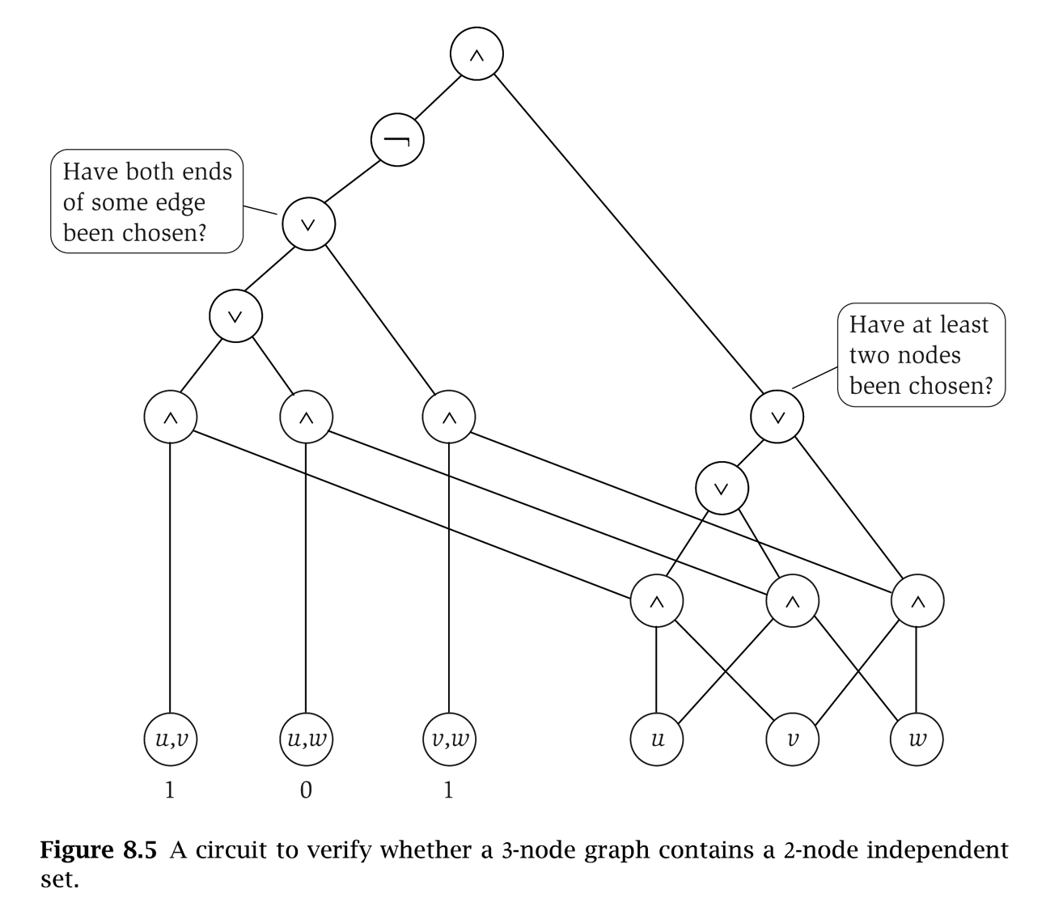
An example: independent set
u
v
w
G = (V, E), n = 3
Notes:
1,0,1 + 1,0,1
If: 1,0,1 + 1,1,…

Slide 18
Establishing NP-Completeness
Remark. Once we establish first "natural" NP-complete problem,
others fall like dominoes.
Recipe to establish NP-completeness of problem Y.
  Step 1. Show that Y is in NP.
  Step 2. Choose an NP-complete problem X.
  Step 3. Prove that X ≤ _{p} Y.
Justification. If X is an NP-complete problem, and Y is a problem in NP with the property that X ≤ _{P} Y then Y is NP-complete.
Pf. Let W be any problem in NP. Then W ≤ _{P} X ≤ _{P} Y.
  By transitivity, W ≤ _{P} Y.
  Hence Y is NP-complete. ▪
by definition of
NP-complete
by assumption

Slide 19




3-SAT is NP-Complete
Theorem. 3-SAT is NP-complete.
Pf. Suffices to show that CIRCUIT-SAT ≤ _{P} 3-SAT since 3-SAT is in NP.
  Let K be any circuit.
  Create a 3-SAT variable x_{i} for each circuit element i (node i).
  Make circuit compute correct values at each node:
    x₂ = ¬ x₃ ⇒ add 2 clauses:
    x₁ = x₄ ∨ x₅ ⇒ add 3 clauses:
    x₀ = x₁ ∧ x₂ ⇒ add 3 clauses:
  Hard-coded input values and output value.
    x₅ = 0 ⇒ add 1 clause:
    x₀ = 1 ⇒ add 1 clause:
  Final step: turn clauses of length < 3 into
  clauses of length exactly 3. ▪
output
x₀
∧
x₁
x₂
∨
¬
x₅
x₄
x₃
0
?
?
Notes:
φ 0 = x0 ∧ ¬x5 ∧ (x0 ↔ (x1 ∧ x2)) ∧ (x1 ↔ (x4 ∨ x5)) ∧ (x2 ↔ ¬x3)
Expand:
X0 ⬄ x1 ∧ x2 : (x0 => x1 ∧ x2 ) ∧ (x1 ∧ x2 => x0) : [(x0=>x1) ∧ (x0=>x2) ∧ (x1 ∧ x2 => x0)] : [(!x0 ∨ x1) ∧ (¬x0 ∨ x2) ∧ (¬x0 => ¬ (x1 ∧ x2 )] : [(¬x0 ∨ x1) ∧ (¬x0 ∨ x2) ∧ (¬x0 => (¬x1 ∨ ¬x2) )] : [(¬x0 ∨ x1) ∧ (¬x0 ∨ x2) ∧ (x0 ∨ ¬x1 ∨ ¬x2 )]
The last step is to ensure that all clauses have exactly 3 literals. For all clauses that have less than 3 literals, we “pad” them with spare variable(s). For example, if a clause has 2 literals and is of the form (x ∨ y), then we use an extra variable p and replace the clause with two clauses (x ∨ y ∨ p) and (x ∨ y ∨ ¬p). No matter how we set p, one of x and y must be true for the two clauses to both be true. For clauses with only 1 literal, then we simply use 2 variables and replace the clause with 4 new clauses with all combinations of the literals of p, q, and their negations.

Slide 20
NP-Completeness
Observation. All problems below are NP-complete and polynomial reduce to one another!
by definition of NP-completeness
CIRCUIT-SAT
3-SAT
3-SAT reduces to INDEPENDENT SET
INDEPENDENT SET
DIR-HAM-CYCLE
GRAPH 3-COLOR
SUBSET-SUM
VERTEX COVER
HAM-CYCLE
PLANAR 3-COLOR
SCHEDULING
SET COVER
TSP
Notes:
Karp analyzed most juicy open problem in discrete math – showed most were NP-complete
x -> y means x reduces to y (if you can solve y, then you can solve x)
Then to join the NP complete club, you need a reduction from SAT (or any other current member) to you

Slide 21
Some NP-Complete Problems
Six basic genres of NP-complete problems and paradigmatic examples.
  Packing problems: SET-PACKING, INDEPENDENT SET.
  Covering problems: SET-COVER, VERTEX-COVER.
  Constraint satisfaction problems: SAT, 3-SAT.
  Sequencing problems: HAMILTONIAN-CYCLE, TSP.
  Partitioning problems: 3D-MATCHING 3-COLOR.
  Numerical problems: SUBSET-SUM, KNAPSACK.
Practice. Most NP problems are either known to be in P or NP-complete.
Notable exceptions. Factoring, graph isomorphism, Nash equilibrium.
Notes:
Nash equilibria in two-person non-zero-sum game always exist, but major open question to *find* such a solution in poly-time. [Is there a corresponding decision problem or is only the search problem interesting from a computational complexity viewpoint?]

Slide 22
Extent and Impact of NP-Completeness
Extent of NP-completeness. [Papadimitriou 1995]
  Prime intellectual export of CS to other disciplines.
  6,000 citations per year (title, abstract, keywords).
    more than "compiler", "operating system", "database"
  Broad applicability and classification power.
  "Captures vast domains of computational, scientific, mathematical endeavors, and seems to roughly delimit what mathematicians and scientists had been aspiring to compute feasibly."
NP-completeness can guide scientific inquiry.
  1926: Ising introduces simple model for phase transitions.
  1944: Onsager solves 2D case in tour de force.
  19xx: Feynman and other top minds seek 3D solution.
  2000: Istrail proves 3D problem NP-complete.
Notes:
Ernst Ising proposed simple model for phase transitions that is of fundamental importance in physics.
One of most exiting periods in statistical mechanics when Norwegian chemist Lars Onsager (and Nobel laureate) discovered solution to Ising model of ferromagnetism on 2D lattice.
Result energized many of the most brilliant physicist and mathematicians for solution to more realistic 3D model.
Spin glass Ising model from statistical mechanics (2d version unrealistic, 3d is the one everyone wanted to sovle)

Slide 23
More Hard Computational Problems
Aerospace engineering: optimal mesh partitioning for finite elements.
Biology: protein folding.
Chemical engineering: heat exchanger network synthesis.
Civil engineering: equilibrium of urban traffic flow.
Economics: computation of arbitrage in financial markets with friction.
Electrical engineering: VLSI layout.
Environmental engineering: optimal placement of contaminant sensors.
Financial engineering: find minimum risk portfolio of given return.
Game theory: find Nash equilibrium that maximizes social welfare.
Genomics: phylogeny reconstruction.
Mechanical engineering: structure of turbulence in sheared flows.
Medicine: reconstructing 3-D shape from biplane angiocardiogram.
Operations research: optimal resource allocation.
Physics: partition function of 3-D Ising model in statistical mechanics.
Politics: Shapley-Shubik voting power.
Pop culture: Minesweeper consistency.
Statistics: optimal experimental design.

